Slide 1
Decision Statement and Loops

Slide 2
Session 7
Topic 1: Decision Statements in Python
Relational operators
Asking questions and receiving answers
Conditional execution
Indenting the code
IF-ELSE statements
ELIF clauses
Topic 2: Loops in Python
WHILE loops
FOR loops
Controlling loops with BREAK and CONTINUE

Slide 3
Decision Statements in Python

Slide 4
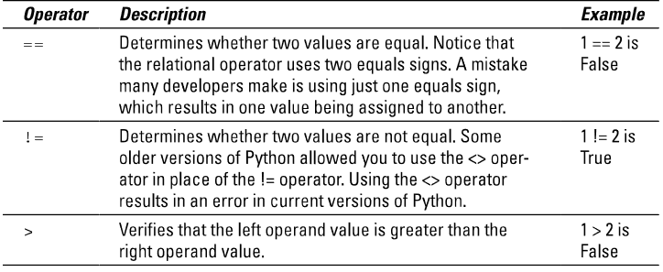
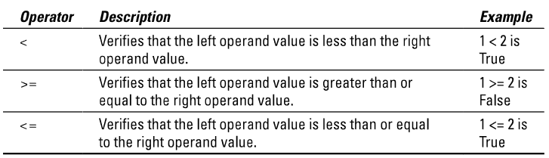
Relational operators
Relational operators compare two values and provide information about the relationship they have. These can be combined with logical operators (AND/OR/NOT).

Slide 5

Asking questions and receiving answers
We can’t talk with our computers normally,
but we do have:
Boolean operators
These work based upon truth statements and their answers.
They will generally use relational operators to define the relation of the operands in the truth statement.
Generally: True = yes, False = no.
So we can:
Ask the computer a question: a Truth statement
Receive an answer: True or False <-Remember, these keywords always begin with a capital.

Slide 6
Conditional execution
Conditional execution is the way you can control what code runs and what code doesn’t (this can be based on inputs or certain values within the code).
Conditional statements will only run if their truth value is True.

Slide 7

Conditional execution
Let’s try and see what truth (True or False) the following condition statements would give:
X=5
if X > 3
if X < 2
if X > 3 and X < 2
if X > 3 or X < 2
if not X > 3

Slide 8
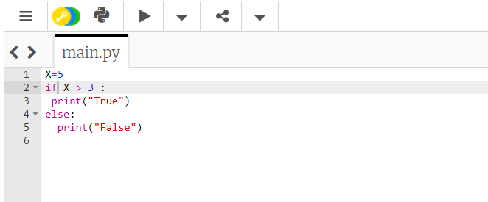
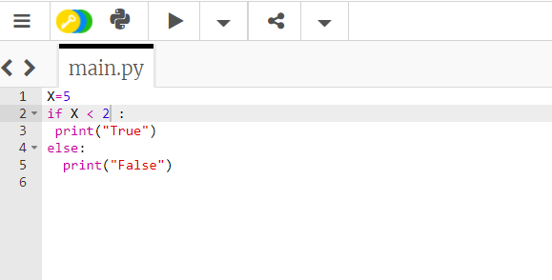
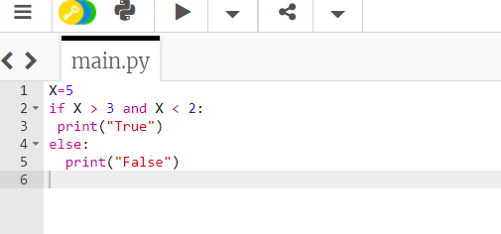
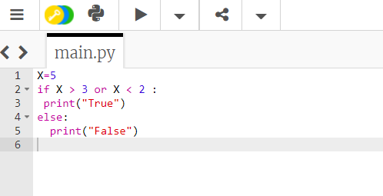
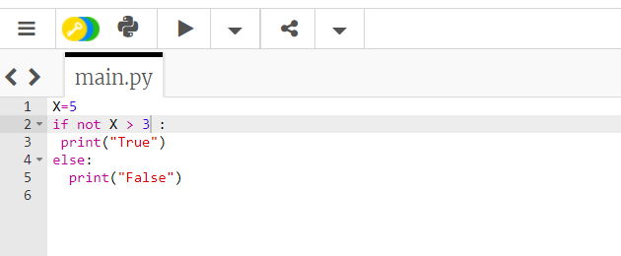

Slide 9
Indenting the code
Indentations control the flow and order of your code execution.
You increase the indentation to begin subroutines/multiline structures.
Both tabs and spaces can be used for indentation purposes, but be careful, use one type and make sure you’re consistent (tabs are generally easier and more visually pleasing.)
This occurs after a : symbol (indentation will be automatic by pressing enter after a colon).
You maintain indentations to continue the same subroutine.
You decrease the indentation to return back out of a subroutine.
For detailing what should happen after that subroutine runs.

Slide 10
Indenting the code
We’ll talk about the different types of conditional statements or loops soon, but one thing to note is that any of them can be nested inside one another.
You could have an if statement and within its statements another if statement, the same happens with your loops, too.
Let’s have a brief look at some nested statements and the indentation involved.

Slide 11
Indenting the code
So:
x=5
if x == 5:
if x >0:
print(“x is above 0”)
else:
print(“x is less than 0”)
else:
print(“x isn’t 5”)

Slide 12
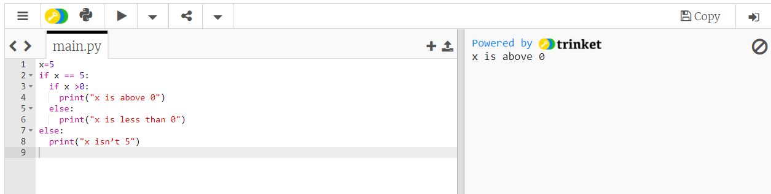

Slide 13
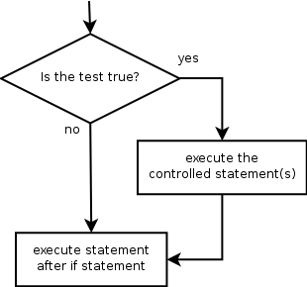
IF-ELSE statements
if-else statements allow us to give a branching path to our code.
if statement: Executes a group of statements only if a certain condition is true. Otherwise, the statements are skipped.
Syntax:
if condition:
statements
Example:
gpa = 3.4
if gpa > 2.0:
print("Your application is accepted.“)

Slide 14
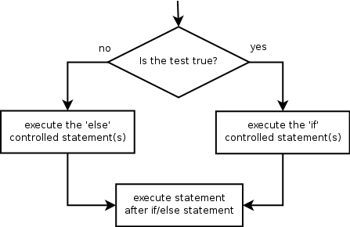
IF-ELSE statements
If-else statement: Executes one block of statements if a certain condition is True, and a second block of statements if it is False.
Syntax:
if condition:
statements
else:
statements
Example:
gpa = 1.4
if gpa > 2.0:
print("Your application is accepted.“)
else:
print("Your application is denied.“)

Slide 15
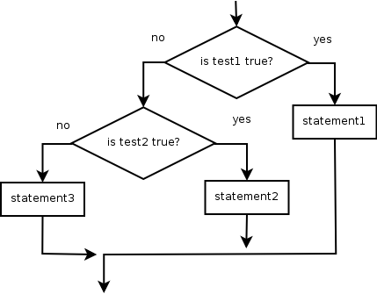
ELIF clauses
Multiple conditions can be chained with elif ("else if"):
if condition:
statements
elif condition:
statements
else:
statements
This is called a cascade.
You can insert as many elif statements as you like between the if and else.
The flowchart would soon become a large set of stairs.
If you have to think of the scenario in terms of “otherwise”, you’ll use elif:
“If this is true, do this; otherwise if this is true, do this;
otherwise if this is true, do this; else, if nothing is true, do this.”

Slide 16
Loops in Python

Slide 17
WHILE loops
While loops also use truth statements and conditional execution.
While loops will continue to run their subroutine while a value is true.
If the loop never reaches a False value, it will keep going.
If you get stuck in an infinite loop, hit Ctrl+C

Slide 18
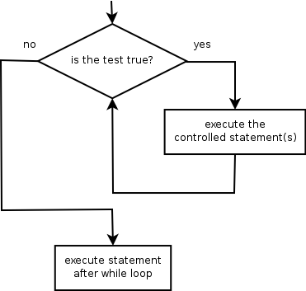
WHILE loops
while loop: Executes a group of statements as long as a condition is True.
good for indefinite loops (repeat an unknown number of times)
Syntax:
while condition:
statements
Example:
number = 1
while number < 200:
print(number),
number = number * 2
Output:
1 2 4 8 16 32 64 128

Slide 19
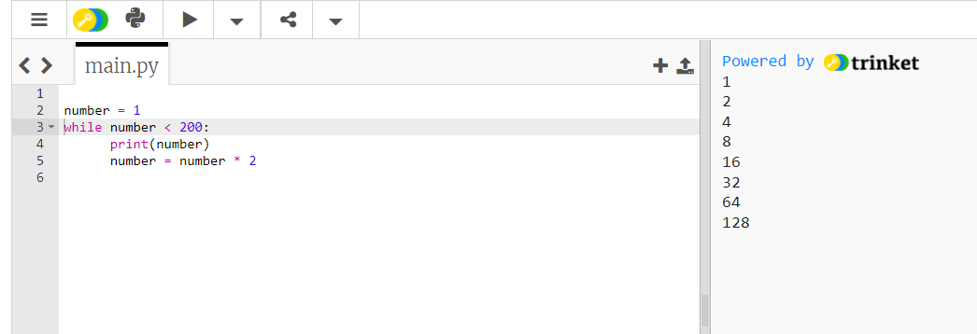

Slide 20
FOR loops
for loop: Repeats a set of statements over a group of values.
Syntax:
for variableName in groupOfValues:
statements
We indent the statements to be repeated with tabs or spaces.
variableName gives a name to each value, so you can refer to it in the statements.
groupOfValues can be a range of integers, specified with a range function. It can also be a variable, list, tuple, or any iterative data type.
Example:

Slide 21
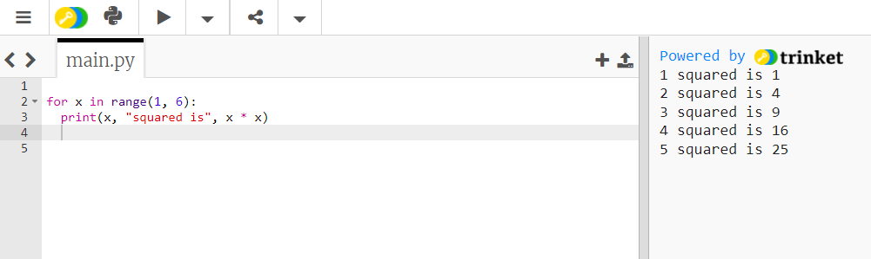

Slide 22
Range
The range function specifies a range of integers:
range(start, stop) - the integers between start (inclusive) and stop (exclusive)
It can also accept a third value specifying the change between values.
range(start, stop, step) - the integers between start (inclusive) and stop (exclusive) by step
Example:
for x in range(5, 0, -1):
print(x)
print("Blastoff!")
Output:
5
4
3
2
1
Blastoff!

Slide 23
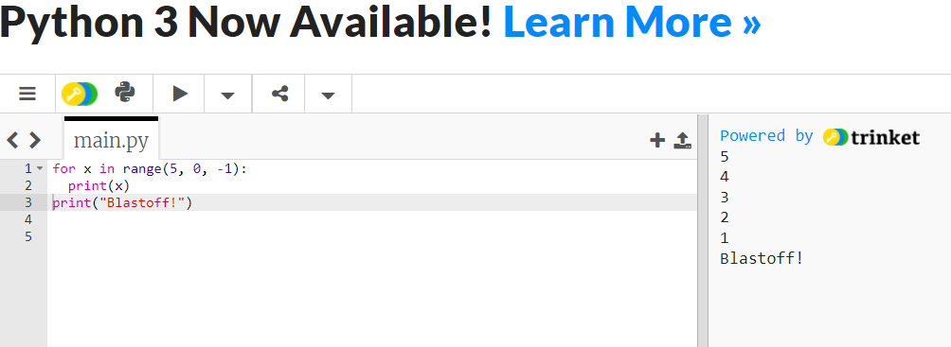

Slide 24
Cumulative Loops
Some loops incrementally compute a value that is initialized outside the loop. This is sometimes called a cumulative sum.
sum = 0
for i in range(1, 11):
sum = sum + (i * i)
print(“sum of first 10 squares is", sum)
Output:
sum of first 10 squares is 385

Slide 25
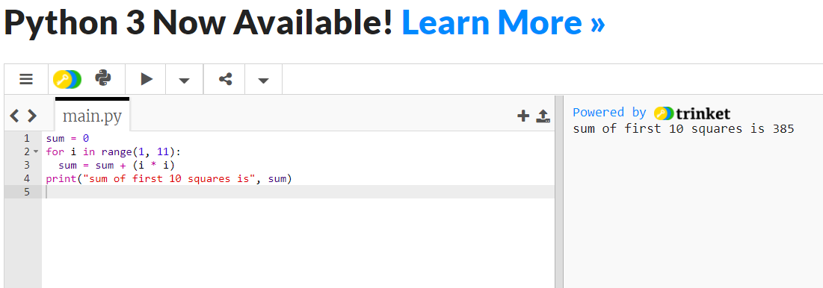

Slide 26
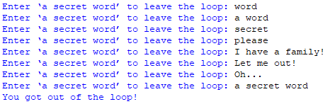
Controlling loops with BREAK and CONTINUE
The break keyword will exit a loop immediately and end the loop’s operations, too. The program will then continue from the next line after the loop.
So:
while True:
word = input("Enter ‘a secret word’ to leave the loop: ")
if word == “a secret word":
break
print(“You got out of the loop!")

Slide 27
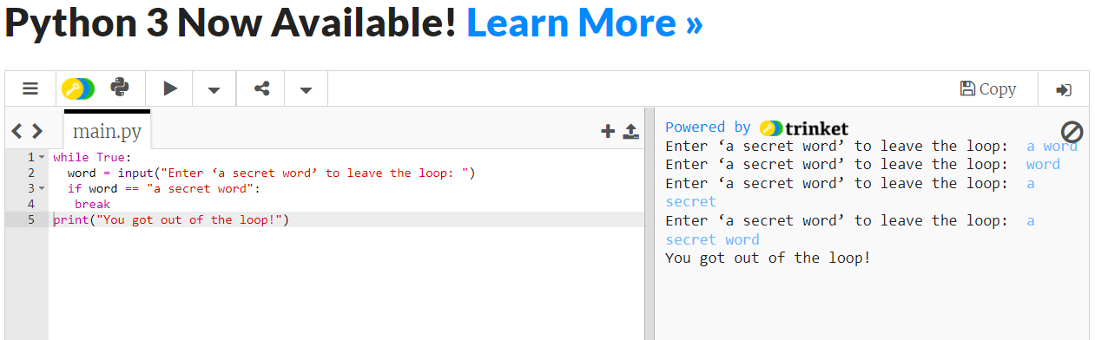

Slide 28
Controlling loops with BREAK and CONTINUE
The continue keyword will cause the loop to stop at that point of code and begin the loop again, acting as though it had reached the end of that cycle (but not executing any code after it).
So:
word = input("Enter your sentence:")
for letter in word:
if letter == " ":
continue
else:
print(letter, end='')
Python’s print() function comes with a parameter called ‘end’. By default, the value of this parameter is ‘\n’,
i.e. the new line character. You can end a print statement with any character/string using this parameter.

Slide 29
